Slide 1
BondCliQ Presentation: How Corporate Bond Data Can Inform Equity Strategies

Slide 2
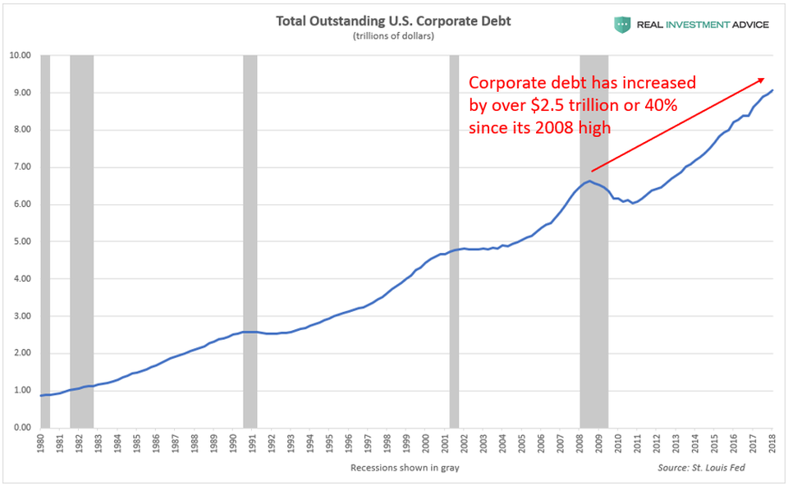
The most valuable financial market data set…that no one is using
Since 2005, the outstanding size of the US corporate bond market has doubled ($11T)
Credit is now foundational to the capital structure of all major companies
Recent research indicates that credit pricing data has material forecasting and signal value
Credit pricing data has been notoriously elusive and unreliable for professional analysis
For the first time, BondCliQ has made corporate bond pricing data available to the broad market

Slide 3
What is BondCliQ Data?
What do we do?
We gather, organize and distribute dealer prices (like the SIP)
Over 40 dealers contributing institutional markets
Data Coverage
Over 65,000 quotes a day across 14k unique bonds
Quote data covers 93% of traded market by volume
Product Details
Tick data set has been equity “tickerized” for analysis
Historical data goes back to September of 2017

Slide 4
BondCliQ Tick Data Example
What can organized corporate bond pricing data do for you?

Slide 5
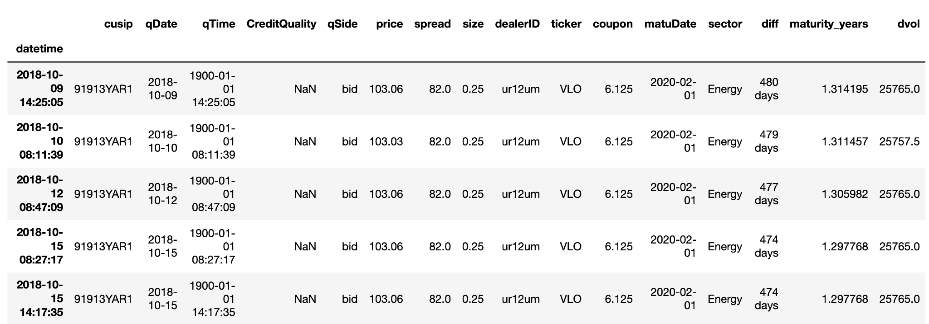
Pre-Quote Data Structure

Slide 6
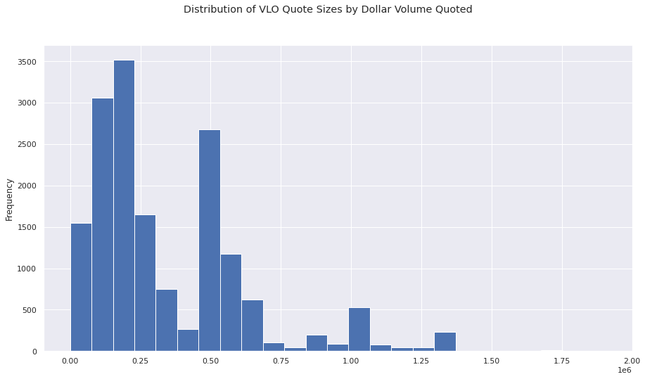
Distribution of VLO Bond Quotes by $ Volume Per Quote

Slide 7
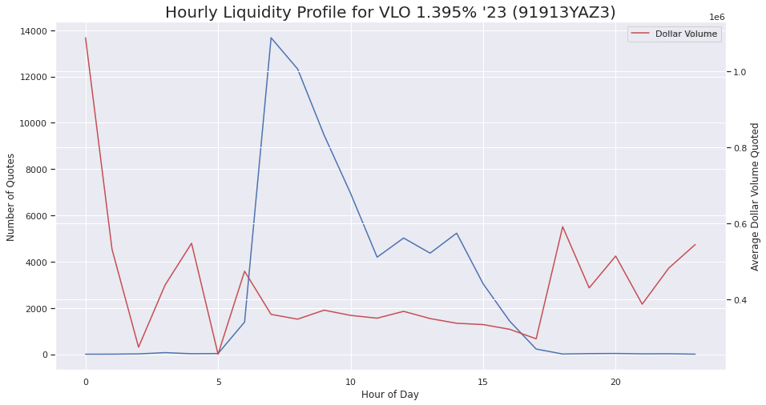
Intraday Bond Liquidity Profile

Slide 8
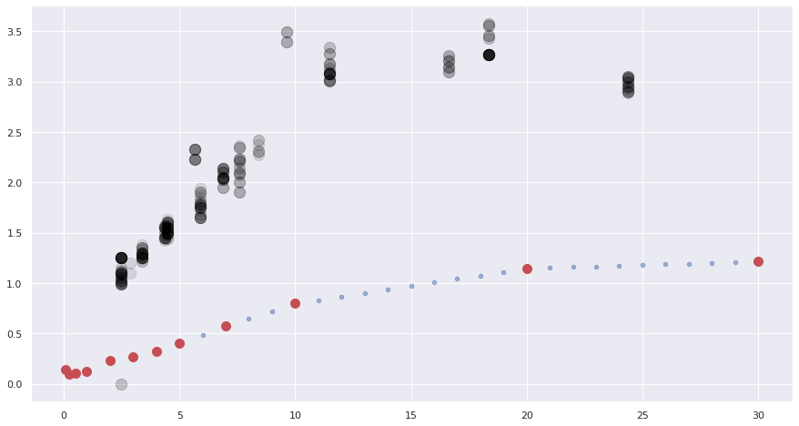
VLO Spread Term Structure:
BondCliQ Implied Pre-trade VLO Spread Term Structure vs. US Swaps Curve, October 27th, 2020

Slide 9
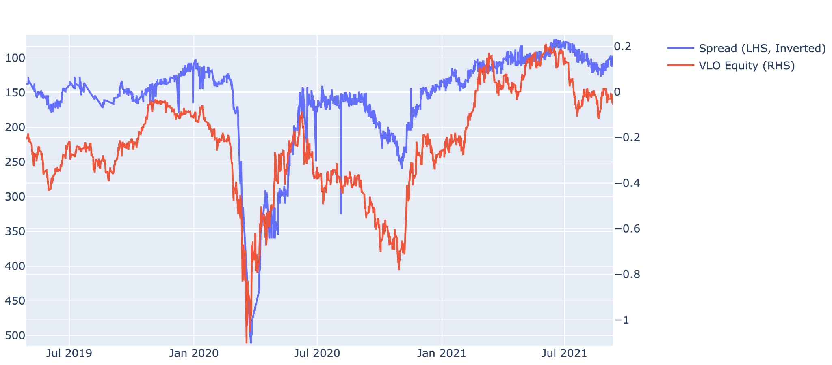
Capital Structures are often coupled
BondCliQ Implied Pre-trade VLO Spreads (VLO 4% 2029) vs. Equity Return
At times, credit prices/spreads can be a leading indicator for equity performance
Pre-Trade Quote Implied Spread begins widening several days before equity responds

Slide 10
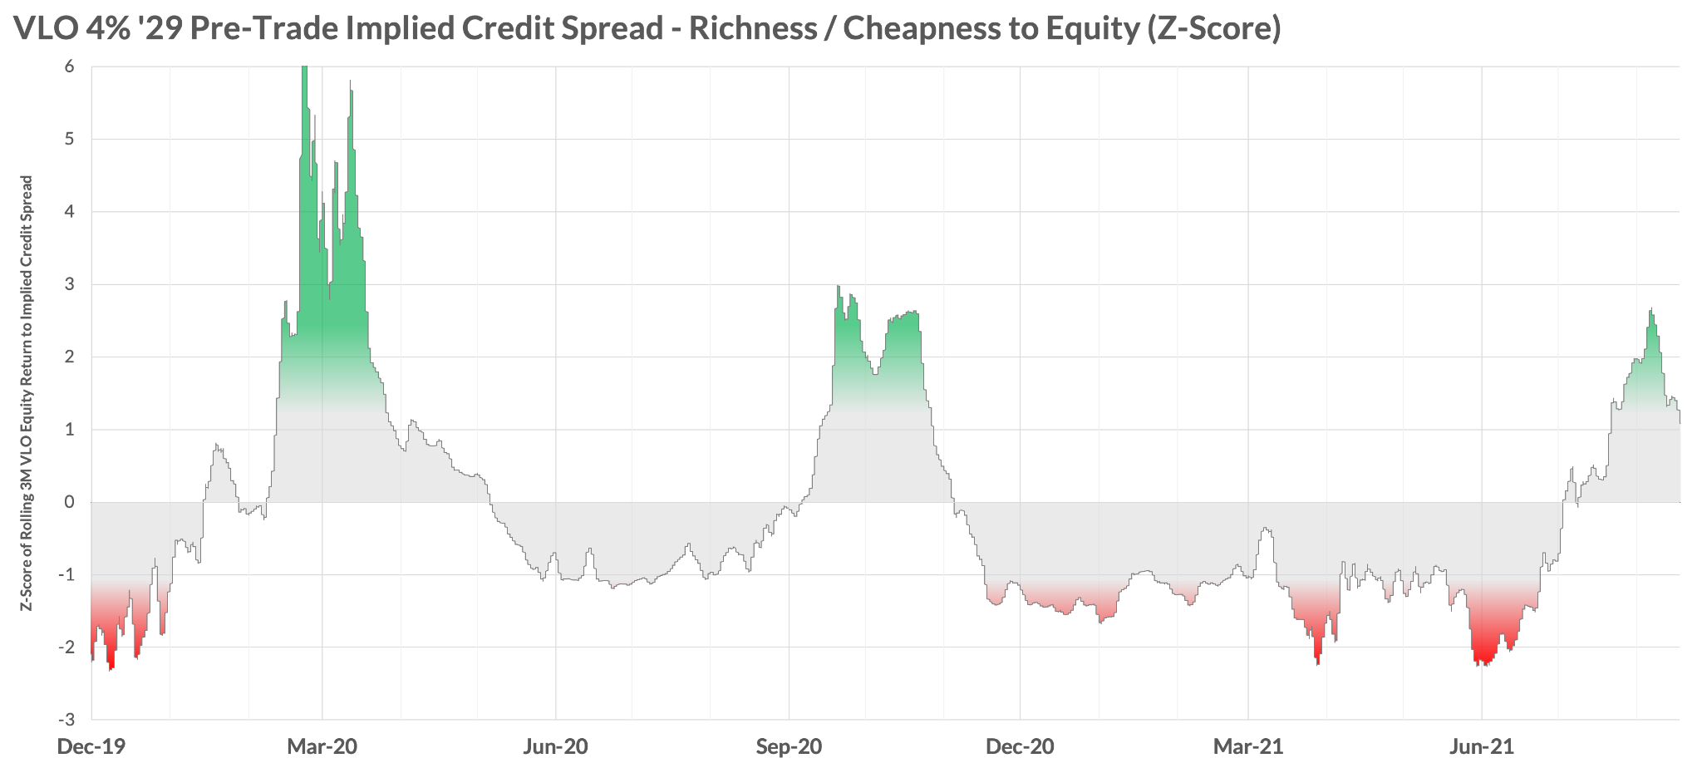
VLO Debt/Equity Relative Value: Quantifying Credit & Equity Rich/Cheap
BondCliQ pre-trade implied VLO credit spreads began widening out in Late-Dec/Early-Jan, well before the precipitous market crash in March. This simple framework has signaled other compelling relative value opportunities in Q4-20 and more recently.
Credit “Cheap” / Equity “Rich” (Spreads Wide vs. Equity)
Equity “Cheap” / Credit “Rich” (Spreads Tight vs. Equities)

Slide 11
Opportunity Awaits
What happens in one asset class segment tends to spill over and effect others, you can’t ignore it
You don’t have to be a traditional credit investor for this to matter
Discretionary – get insight into an essential part of the capital structure
Macro – be aware of what is happening across sectors
Systematic – new source of potential alpha
Quant friendly data set covering an 11 trillion dollar market
Turn key data - no time spent trying to ingest and format
Many bonds in a sea of stocks equals opportunity
Atomic level of resolution allows extrapolation from bond up to issuer, sector, whole asset class
BondCliQ Quote Data
Available via real time API, SFTP files, vendor partners, proprietary GUI
Daily macro credit/equity liquidity report coming Q1
Europe launch Q1 2022

